Slide 1
Mountainboard - Lesson 4
Revolved Features – The Wheel Hub
School’s Name
Teacher’s Name
Date

Slide 2



Revolve Feature Overview
A Revolve feature is created by rotating a 2D profile sketch around an axis of revolution.
The profile sketch can use a sketch line or a centerline as the axis of revolution.
The profile sketch cannot cross the axis of revolution.
Good
Good
No Good

Slide 3
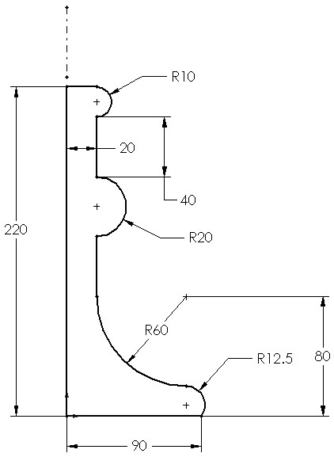
Creating a Revolve Feature
Select a sketch plane.
Sketch a 2D profile.
(Optional) Sketch a centerline.
  The axis of revolution must be in the sketch with the profile. It cannot be in a separate sketch.
  The profile must not cross the centerline.
Centerline

Slide 4
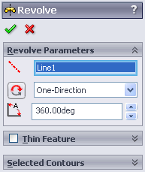
Creating a Revolve Feature
Click Revolved Boss/Base .
Specify the angle of rotation and click OK.
  The default angle is 360°, which is right 99+% of the time.

Slide 5
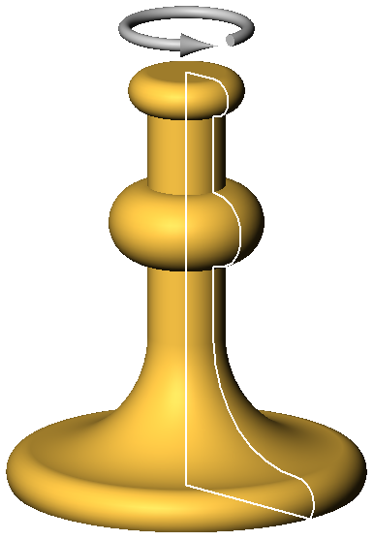
Creating a Revolve Feature
The sketch is revolved around the axis of revolution, creating the feature.

Slide 6
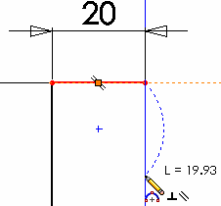
Sketching Arcs – 3 Point Arc
A 3 Point Arc creates an arc through three points – the start, end and midpoint.
To Create a 3 Point Arc:
Click 3 Point Arc on the Sketch Tools toolbar.
Point to the arc start location and
click the left mouse button.
Move the pointer to the arc end location.
Click the left mouse button again.

Slide 7
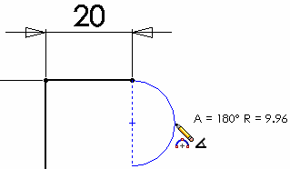
Creating a 3 Point Arc:
Drag the arc midpoint to establish the radius and direction (convex vs. concave).
Click the left mouse button a third time.

Slide 8

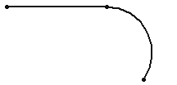
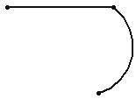
Sketching Arcs – Tangent Arc
The Tangent Arc tool creates an arc that has a smooth transition to an existing sketch entity.
Saves the work of sketching an arc and then manually adding a geometric relation to make it tangent.
Start point of the arc must connect to an existing sketch entity.
Not Tangent
Tangent
Not Tangent

Slide 9
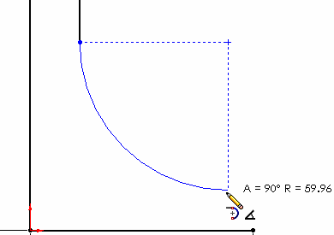
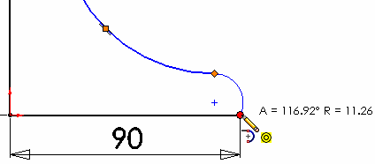
To Create a Tangent Arc:
Arc is tangent to existing line
Click Tangent Arc on the Sketch Tools toolbar.
Point to the arc start location, and click the left mouse button.
Drag to create the arc.
  The arc angle and radius values are displayed on the pointer when creating arcs.
Click the left mouse button.
Arc is tangent to existing arc

Slide 10









Pointer Feedback
As you sketch, the pointer provides feedback and information about alignment to sketch entities and model geometry.
 | Horizontal |  | Midpoint
 | Vertical |  | Intersection
 | Parallel |  | Endpoint, Vertex or Centerpoint
 | Perpendicular |  | On
 | Tangent

Slide 11
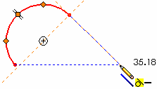
Inferencing
Dotted lines appear when you
sketch, showing alignment
with other geometry.
This alignment information
is called inferencing.
Inference lines are two different colors: orange and blue.
  Orange inference lines capture and add a geometric relation such as Tangent.
  Blue lines show alignment and serve as an aid to sketching, but do not actually capture and add a geometric relation.
Orange
Blue

Slide 12
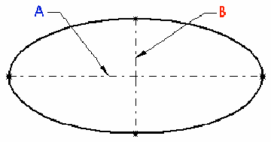
Ellipse Sketch Tool
Used to create the sweep section for the handle of the candlestick.
An Ellipse has two axes:
  Major axis, labeled A
  at the right.
  Minor axis labeled B
  at the right.
Sketching an ellipse is a two-step operation, similar to sketching a 3 Point Arc.

Slide 13
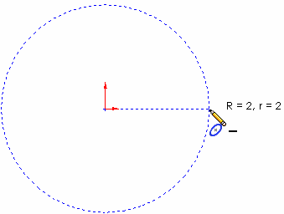
To Sketch an Ellipse:
Click Tools, Sketch Entity, Ellipse.
  Tip: You can use Tools, Customize to add the Ellipse tool to the Sketch Tools toolbar.
Position the pointer at the center of the ellipse.
Click the left mouse
button, and then move
the pointer horizontally
to define the major axis.
Click the left mouse
button a second time.

Slide 14
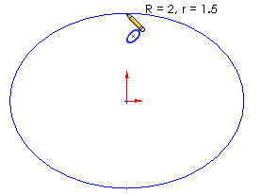
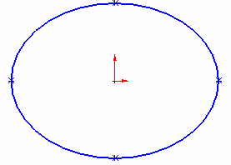
Sketching an Ellipse:
Move the pointer vertically to define the minor axis.
Click the left mouse button a third time. This completes sketching the ellipse.

Slide 15
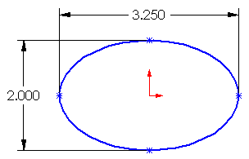
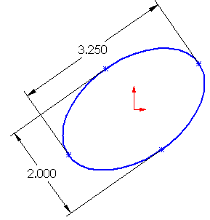
Fully Defining an Ellipse
Requires 4 pieces of information:
Location of the center:
  Either dimension the center or locate it with a geometric relation such as Coincident.
Length of the major axis.
Length of the minor axis.
Orientation of the major axis.
  Even though the ellipse at the right is dimensioned, and its center is located coincident to the origin, it is free to rotate until the orientation of the major axis is defined.

Slide 16
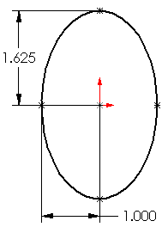
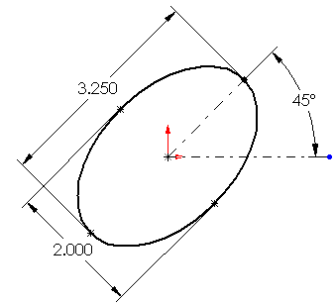
More About Ellipses
The major axis does not have to be horizontal.
You can dimension half the major and/ or minor axis.
  It is like dimensioning the radius of a circle instead of the diameter.
You do not have to use a geometric relation to orient the major axis.
  A dimension works fine.

Slide 17
Trimming Sketch Geometry
The Trim tool is used to delete a sketch segment.
The segment is deleted up to its intersection with another sketch entity.
The entire sketch segment is deleted if it does not intersect any other sketch entity.

Slide 18
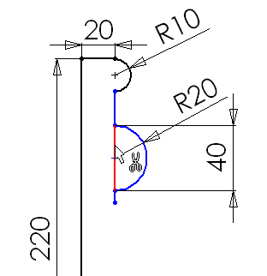
To Trim a Sketch Entity:
Click Trim on the Sketch Tools toolbar.
Position the pointer over the sketch segment.
The segment that will be trimmed is highlighted in red.
Click the left mouse button to delete the segment.

Slide 19
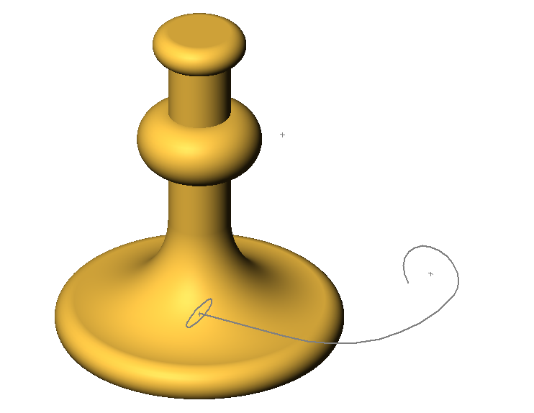
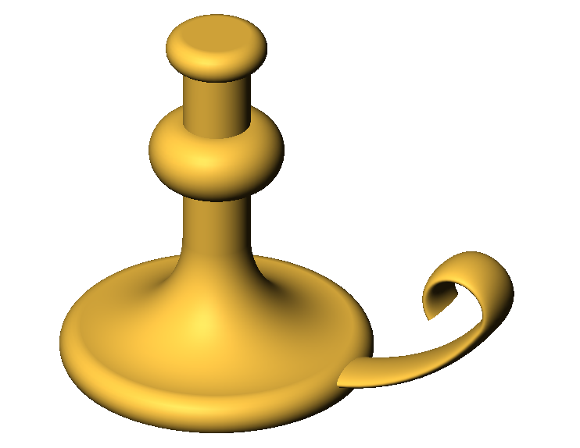
Sweep Overview
The Sweep feature is created by moving a 2D profile along a path.
A Sweep feature is used to create the handle on the candlestick.
The Sweep feature requires two sketches:
  Sweep Path
  Sweep Section
Section
Path

Slide 20
Sweep Overview – Rules
The sweep path is a set of sketched curves contained in a sketch, a curve, or a set of model edges.
The sweep section must be a closed contour.
The start point of the path must lie on the plane of the sweep section.
The section, path or the resulting solid cannot be self-intersecting.

Slide 21
Sweep Overview – Tips
Make the sweep path first. Then make the section.
Create small cross sections away from other part geometry.
Then move the sweep section into position by adding a Coincident or Pierce relation to the end of the sweep path.

Slide 22
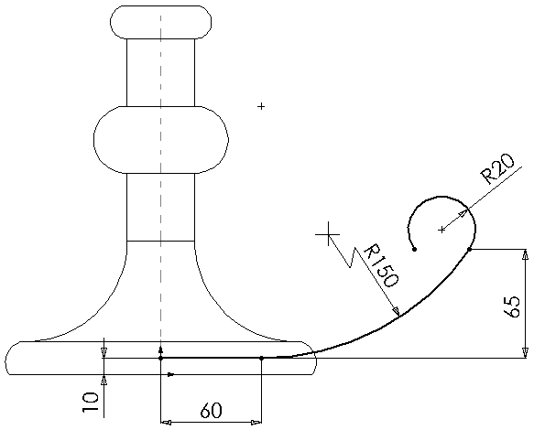
To Create the Sweep Path:
Open a sketch on the Front plane.
Sketch the Sweep path using the Line and Tangent Arc sketch tools.
Dimension as shown.
Close the sketch.

Slide 23
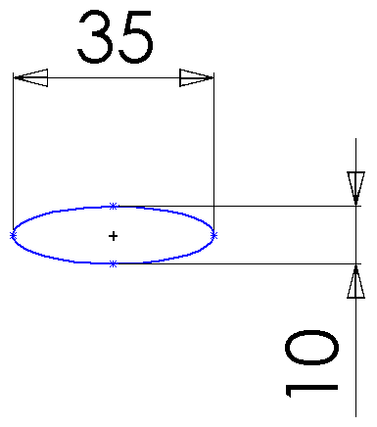
To Create the Sweep Section:
Open a sketch on the Right plane.
Sketch the Sweep section
using the Ellipse sketch
tool.
Add a Horizontal relation between the center of the ellipse and one end of the
major axis.
Dimension the major and
minor axes of the ellipse.
Horizontal

Slide 24
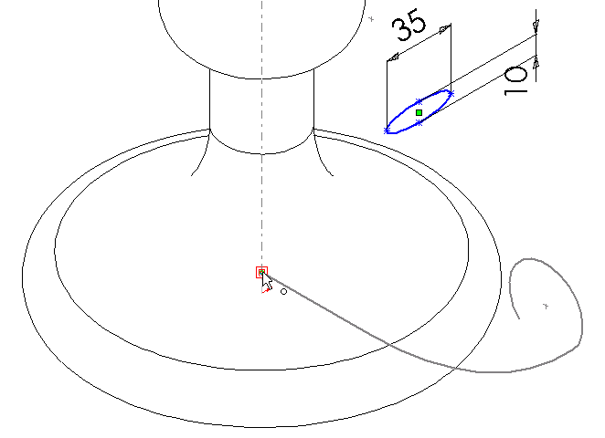
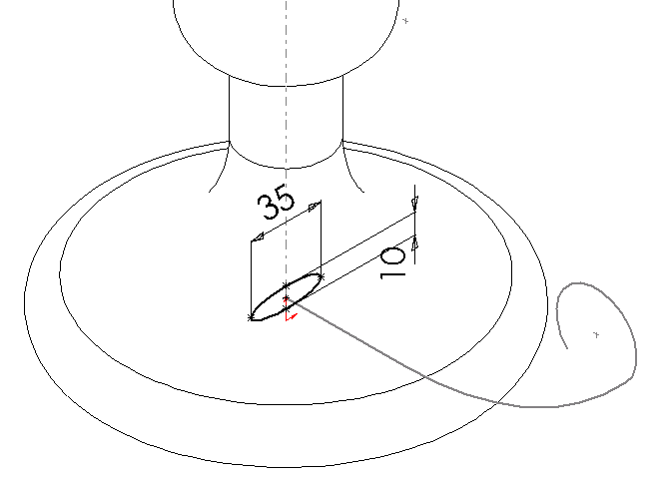
Creating the Sweep Section:
Add a Coincident
relation between the center of the ellipse
and the endpoint of
the path.
Close the sketch.
Coincident

Slide 25
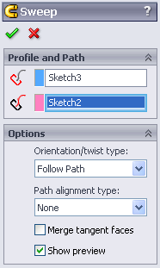
To Sweep the Handle:
Click Sweep on the Features toolbar.
Select the Sweep path sketch.
Select the Sweep section sketch.
Click OK.

Slide 26
Sweeping the Handle – Results

Slide 27
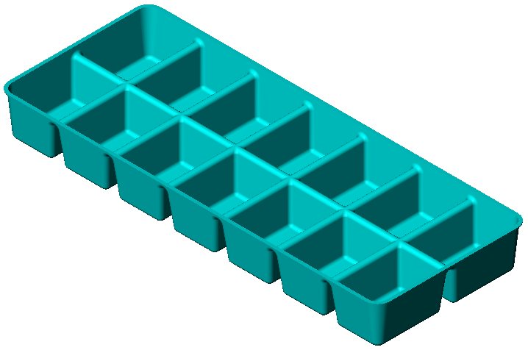
Extruded Cut with Draft Angle
Creates the opening for a candle in the top of the candlestick.
Same process as extruding a boss except it removes material instead of adding it.
Draft tapers the shape.
Draft is important in molded,
cast, or forged parts.
  Example: Ice cube tray –
  without draft it would be very
  hard to get the ice cubes out
  of the tray.
  Find other examples.

Slide 28
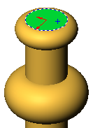
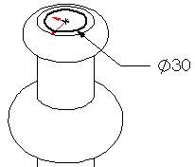
To Create the Cut:
Open a sketch on the top face of the candlestick.
Sketch a circular profile Concentric to the circular face.
Dimension the circle.

Slide 29
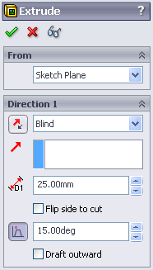
Creating the Cut:
Click Extruded Cut on the Features toolbar.
End Conditions:
  Type = Blind
  Depth = 25mm
  Draft = On
  Angle = 15°
Click OK.

Slide 30
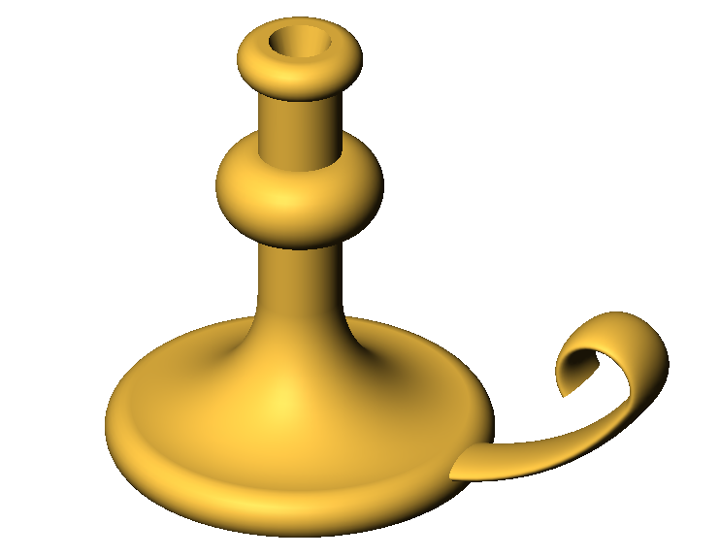
Extruding the Cut– Results

Slide 31

Fillet Feature
Fillets are used to smooth the edges of the candlestick.
Selection Filters
Help in selecting the correct geometry.
Click to turn on Selection Filter toolbar.
Use the Edge selection filter .
Pointer changes appearance when filter is active.

Slide 32
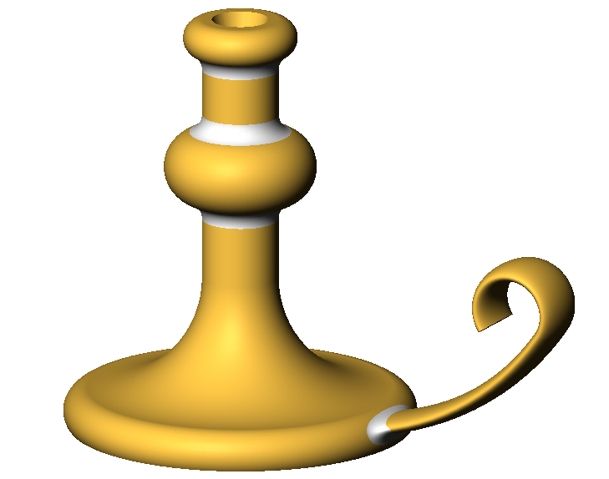
Filleting the Edges – Results
Fillets

Slide 33
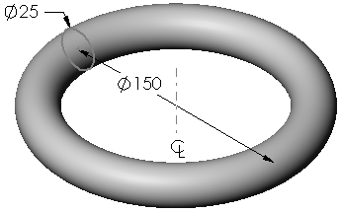
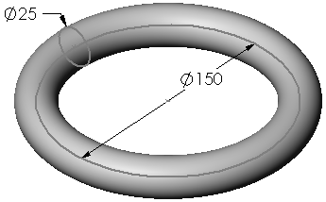
Best Practice – Keep it Simple
Do not use a sweep feature
when a revolve or extrude
will work.
Sweeping a circle along a
circular path appears to
give the same result as a
revolve feature.
However, the revolve feature:
  Is mathematically less complex
  Is easier to sketch – one sketch
  vs. two
Revolve
Sweep

Slide 34
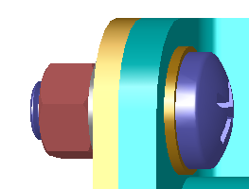
What is Toolbox?
Ready-to-use standard parts such as bolts, screws, washers, lock washers, and so forth.
Eliminates the need to model most fasteners and many other standard parts.
Easy drag-and-drop placement.

Slide 35
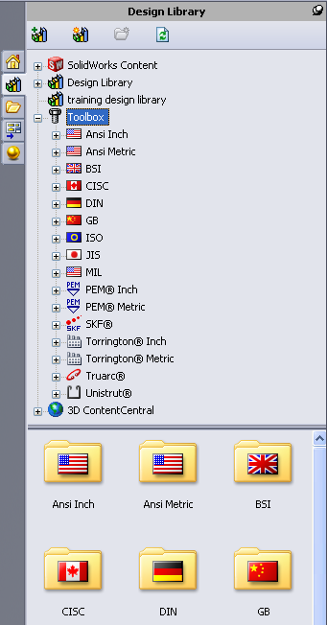
Toolbox Browser
Browser containing libraries of ready-to-use components.
Click to access Toolbox Browser.
Contains libraries of ready-to-use parts.

Slide 36
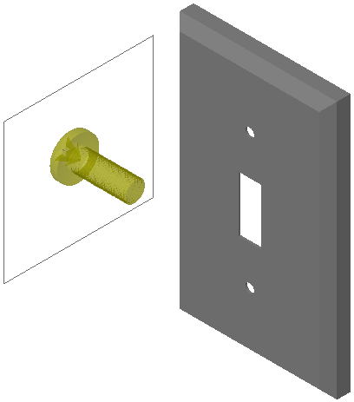
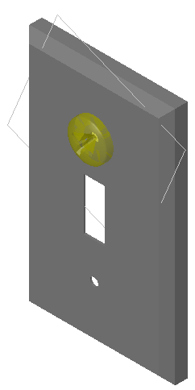
Easy Drag-and-Drop Placement
Drag from Toolbox Browser
Snap to assembly

Slide 37
Mate Relationships Defined at Placement
When the Toolbox part snaps to the assembly, the mate relationship between the Toolbox part and the other part is established.
When using washers, place them first. Subsequent hardware — like screws and nuts — mate to the washers.

Slide 38
Standard Hardware Matches
Standard Holes
Hardware placed on holes created using the Hole Wizard is appropriately sized.
Standard sized parts help to keep your designs realistic.

Slide 39
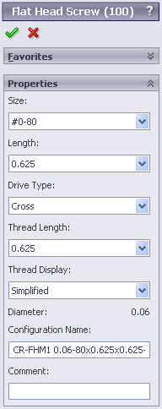
Specifying Toolbox Part Properties
Change part properties to customize the hardware to your design.
  Specify the properties as you are placing the part.
  Ability to change the properties after the part is placed.

Slide 40
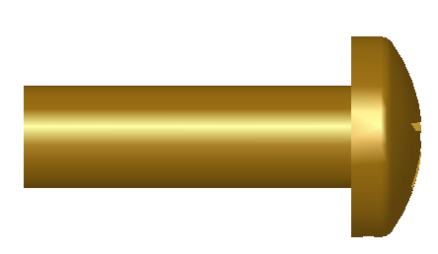
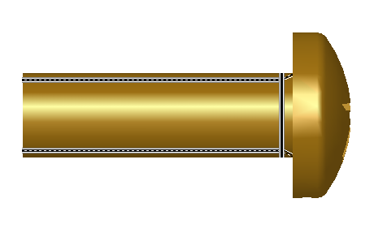
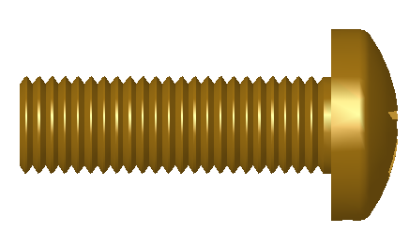
Thread Display
Simplified — Represents the hardware with few details. Most common display.
Cosmetic — Represents some details of the hardware.
Schematic — Very detailed display which is used for unusual or custom designed hardware.

Slide 41
Supported Standards
Toolbox supports international standards
  ANSI
  BSI
  CISC
  DIN
  ISO
  JIS
  GB
  KS
  IS

Slide 42
Libraries from Leading Manufacturers
Toolbox contains standard parts libraries from leading manufacturers such as:
  PEM®
  Torrington®
  Truarc®
  SKF®
  Unistrut®

Slide 43
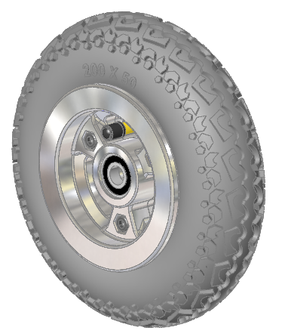
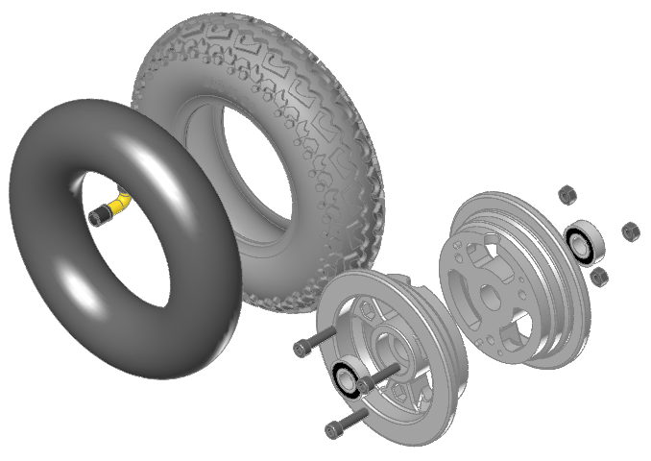
Wheel Assembly

Slide 44
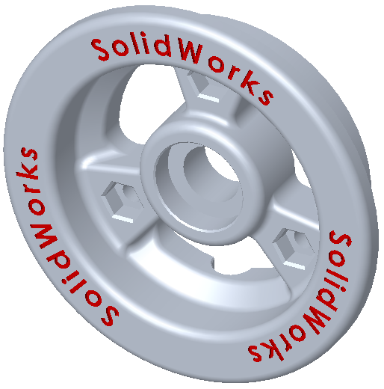
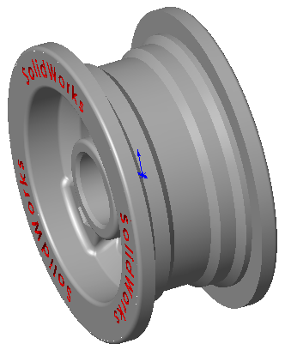
Components
Wheel Hub Design Intent
  The part will be molded from plastic
  Two wheel hubs will fit together to form a single wheel
  Index pins and holes will keep the two hubs from rotating relative to one another
  There must be a passage for the tube stem
  The bolt holes must capture the nuts to keep

Slide 45
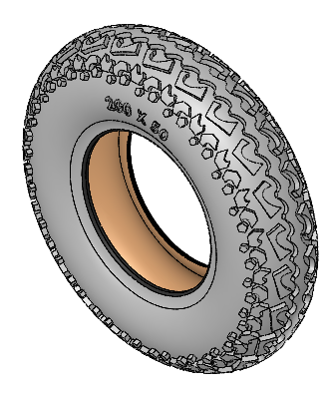
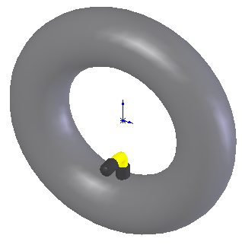
Components
Tire and Tube
  These will both be
  purchased parts
  The models will be
  imported
Bearings, Bolts and Nuts
  These are purchased parts
  Use Toolbox to create the parts

Slide 46
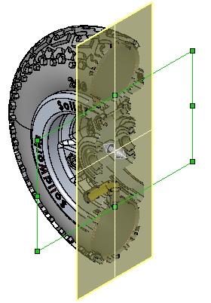
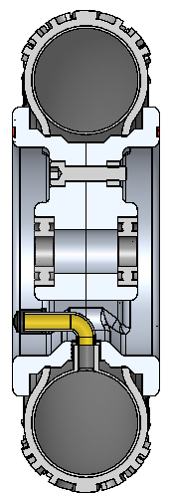
Wheel Assembly
Section View

Slide 47

Wheel Assembly
Exploded View

Slide 48


Additional Parts
The Spring Assembly
will be created later.
It will need the following
parts:

Slide 49


Additional Parts
Fender Washer
  A simple revolved part
  Revolve a rectangle
Spring Dampener
  A simple revolved part
  Uses the 3-point arc

Slide 50



Additional Parts
Spring Retainer
  A revolved part with
  several features
  Add appearance to the part
Compression Spring
  This will be made in a latter lesson.

